Slide 1
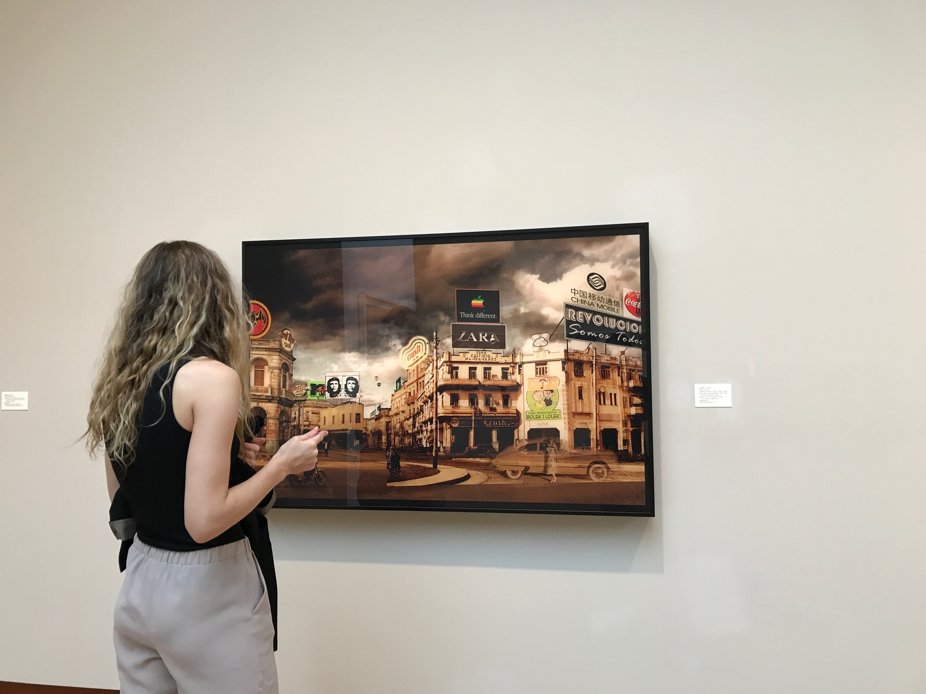
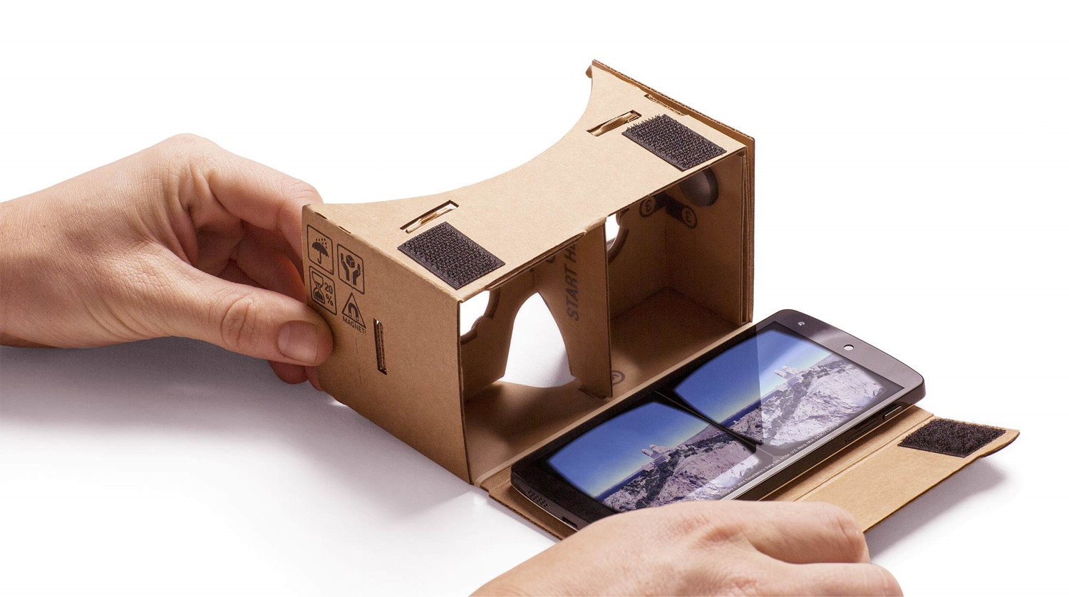
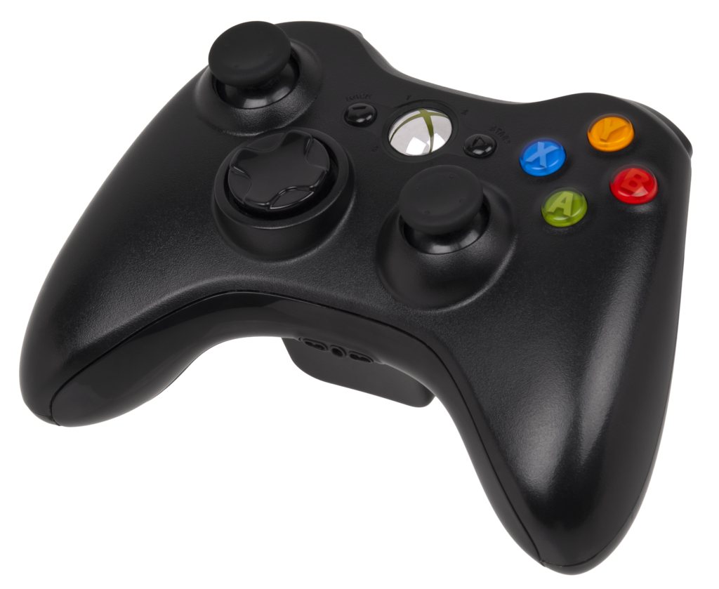
TEAM EP: Liu, Rak-amnouykit, Schaumberg, Yuan
CS-570 INTRODUCTION TO HUMAN-COMPUTER INTERACTION
Purpose:
Given:
Detailed 3D recreation of a museum
Tools:
VR Headset (for visual control)
Peripheral controller ( for movement in 3D space)
Product will enable people to visit a museum from the comfort of of their homes
Experience exhibits as if they were actually there
For prototyping’s sake tools used were:
Google Cardboard VR headset with a 3D recreation of the Museum
Xbox controller to maneuver our user’s placement in the museum
SETTING: Museums

Slide 2
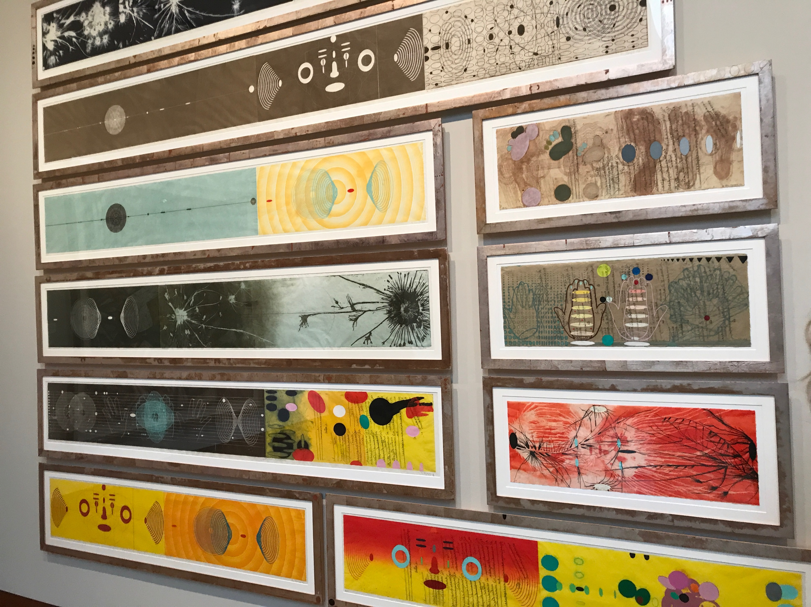
TEAM EP: Liu, Rak-amnouykit, Schaumberg, Yuan
CS-570 INTRODUCTION TO HUMAN-COMPUTER INTERACTION
Breakdowns:
Patrons wanted to stay longer, but couldn’t due to schedule conflicts or fatigue
Lack of ability to organize a group to visit the museum due conflicts, over crowding or personal health issues
Potential visitors separated by great distances from either each other or the museum, making the visit impossible
SETTING: Museums
Viewing Art
Students
Art Enthusiasts
General Museum Attendees (of all ages)

Slide 3
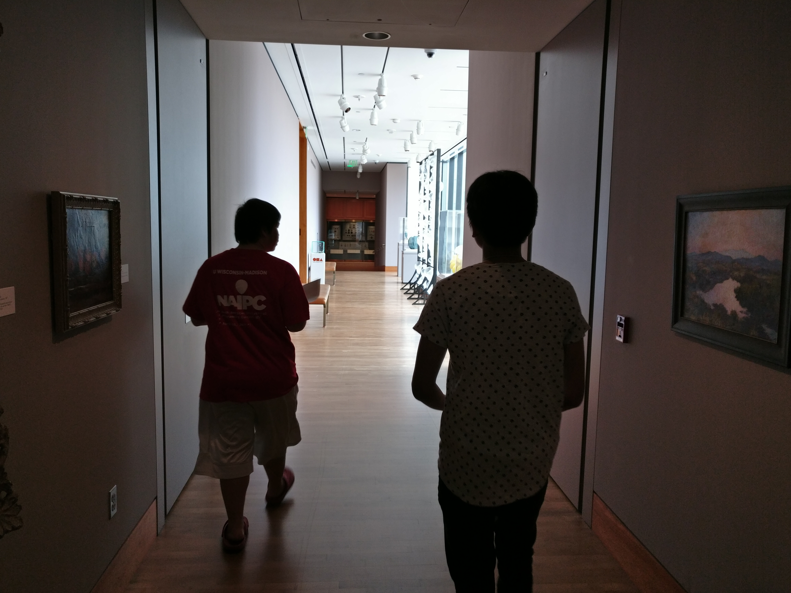
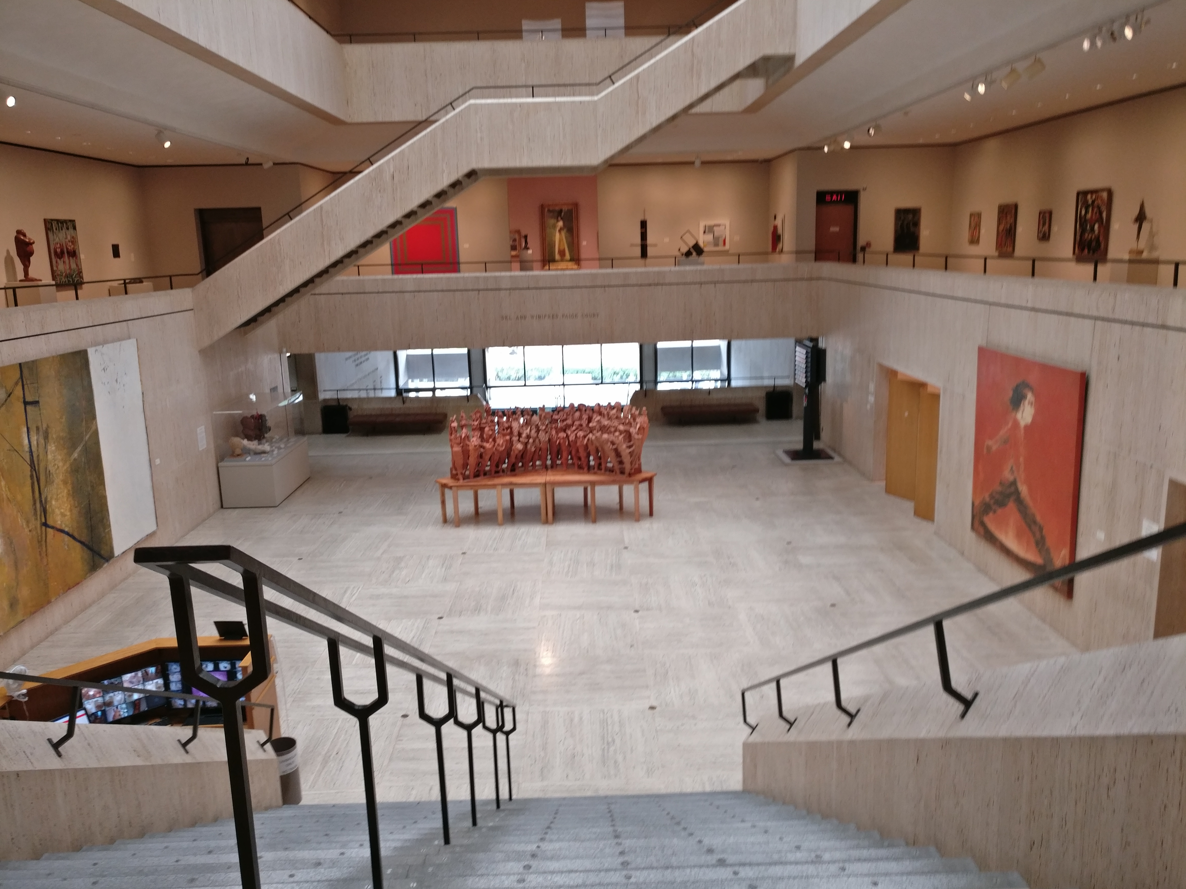
TEAM EP: Liu, Rak-amnouykit, Schaumberg, Yuan
CS-570 INTRODUCTION TO HUMAN-COMPUTER INTERACTION
Usage Scenarios:
Enables a class of students to visit a museum on their own time from home, at museum(s) potentially thousands of miles away.
Interact with your friends without worrying about scheduled hours of a museum
Personal enjoyment: never feel pressure to move through the museum quickly
All without having to ever leave the comfort of your own home
SETTING: Museums

